Slide 1
sMART MOVIE RECOMMENDER
By
Guide
M AKASH
220701502
III CSE B
Dr.V.Auxilia Osvin Nancy.,
M.Tech.,Ph.D.,

Slide 2
Introduction
In today's digital world, users are overwhelmed by the vast number of movie choices available online. A recommendation system helps solve this problem by providing personalized suggestions based on user interests.
This project focuses on building a Content-Based Movie Recommendation System using Natural Language Processing (NLP) techniques. It analyzes movie features such as genre, director, cast, and plot overview to find and recommend similar movies.
The system uses Count Vectorization and Cosine Similarity to identify relationships between movies and assist users in discovering films they are likely to enjoy.

Slide 3
Literature Survey
Ricci et al. (2011) introduced a foundational understanding of various recommendation techniques, highlighting content-based and collaborative filtering models in real-world systems.
Pazzani and Billsus (2007) discussed how content-based recommendation utilizes user profiles and item features, suitable for domains like movies and news.
Salakhutdinov et al. (2007) explored Restricted Boltzmann Machines (RBM) for collaborative filtering, paving the way for deep learning in recommender systems.
He et al. (2017) proposed Neural Collaborative Filtering (NCF), combining neural networks with user-item interactions for improved recommendation accuracy.
Reimers and Gurevych (2019) introduced Sentence-BERT, which improved semantic understanding in NLP-based recommendations by producing high-quality sentence embeddings.

Slide 4
Objectives
To ensure a user-friendly interface using Flask, allowing users to input movie names and receive personalized recommendations.
To provide meaningful and accurate recommendations by leveraging key movie attributes like genre, overview, director, and cast.
To handle errors and exceptions gracefully, improving the overall robustness and usability of the system.
To develop a content-based movie recommendation system that suggests similar movies based on user input.
To utilize Natural Language Processing (NLP) techniques such as CountVectorizer and Cosine Similarity for extracting features and computing similarity of movies.

Slide 5
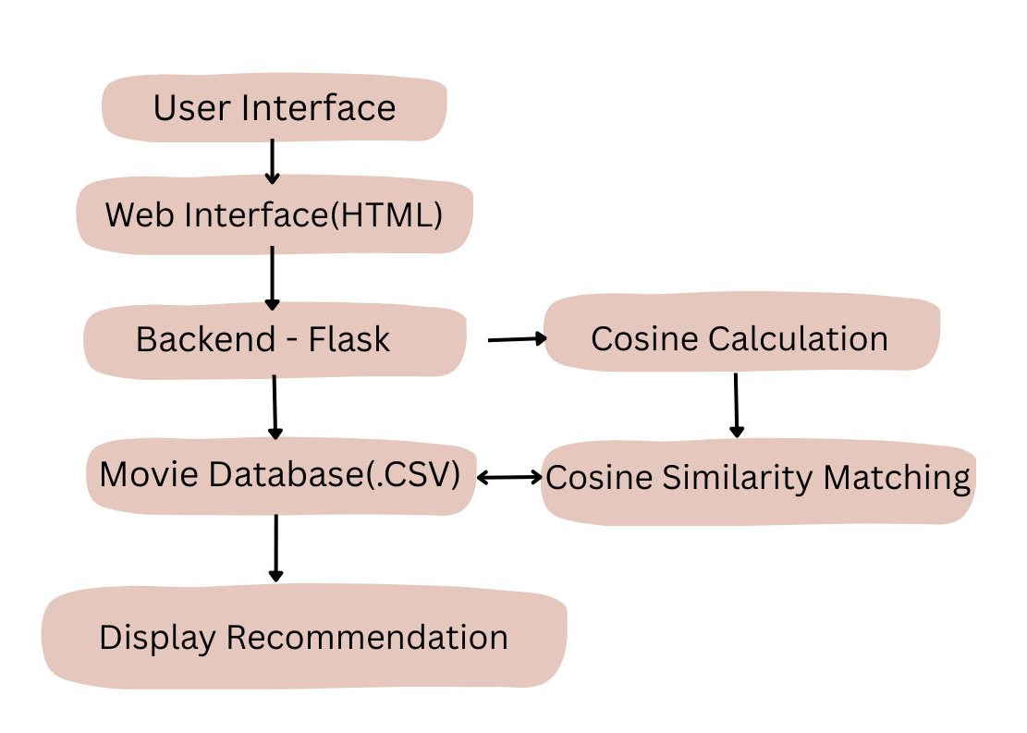
System Architecture

Slide 6
Methodology
Data Collection
The dataset was sourced from a publicly available movie CSV file containing essential features such as title, genre, director, cast, overview, ratings, and more.
Data Preprocessing
Missing values were handled by replacing them with empty strings.
All movie titles were converted to lowercase for consistent matching.
Feature Engineering
Important textual fields (overview, genre, director, stars) were combined into a single string to represent each movie’s content.
This combined text was then vectorized using CountVectorizer to convert it into a numerical format.
Similarity Calculation
Cosine Similarity was used to compute similarity scores between all movies based on their vectorized features.
Recommendation Logic
When a user enters a movie name, the system finds the most similar movies based on the similarity matrix and returns the top recommendations.
User Interface
A simple web interface was developed using Flask, allowing users to input a movie title and receive recommendations along with relevant movie details.

Slide 7
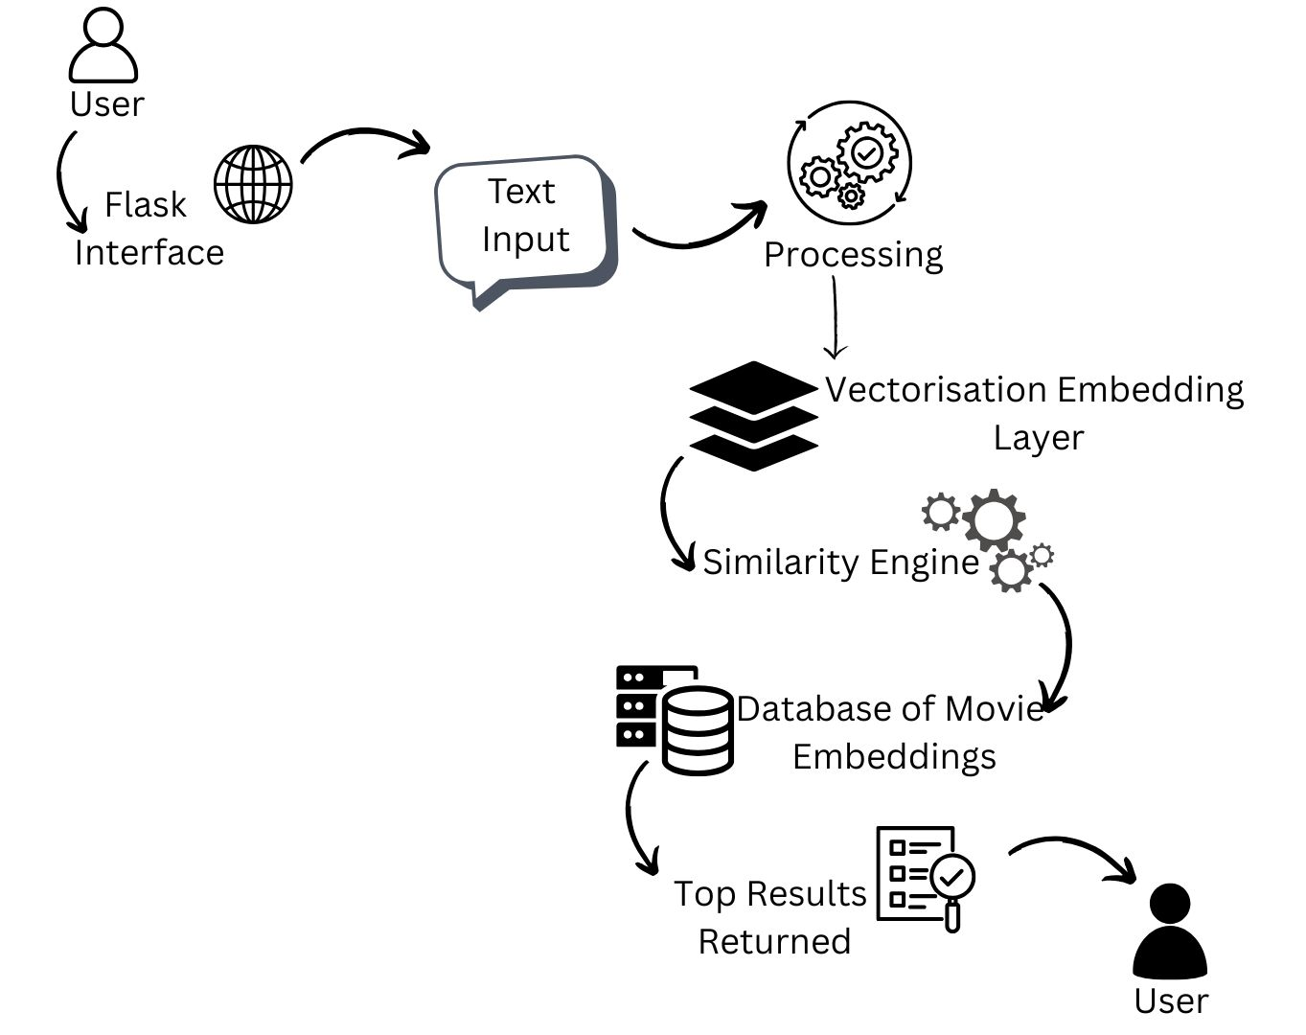
Implementation

Slide 8
Results
The system successfully provides personalized movie recommendations.
Input: User enters a movie name (e.g., The Matrix).
Output: Displays top 5–6 similar movies with:
Poster image
Title, Genre, Director, and Stars
IMDB Rating, Year of Release, Overview
Recommendations are based on content similarity using text features.
User-friendly interface for entering movie names and viewing results.
Error messages guide the user when input is invalid or not found.

Slide 9
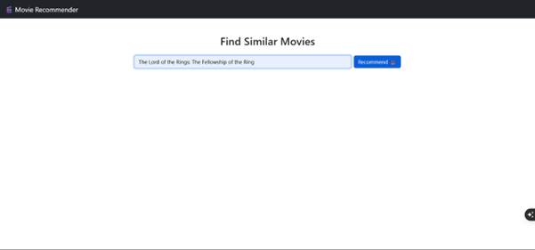
Results

Slide 10
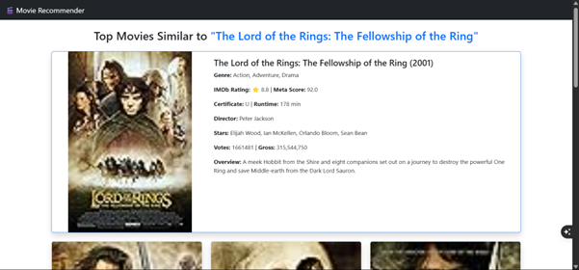
Results

Slide 11
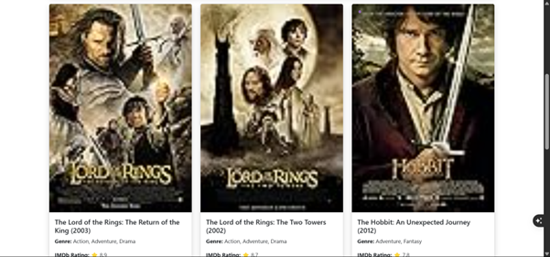
Results

Slide 12
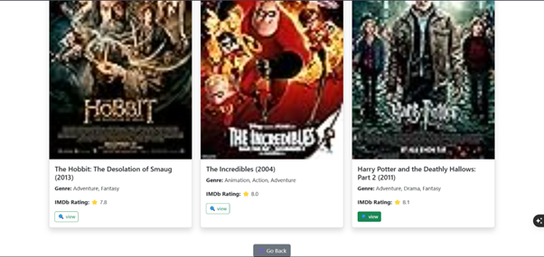
Results

Slide 13
Conclusion and Future Work
Conclusion:
The movie recommendation system effectively suggests similar movies using content-based filtering. It leverages NLP techniques like CountVectorizer and cosine similarity to identify relationships between movies. The system enhances user experience by simplifying movie discovery based on interests.
Future Work:
Incorporate collaborative filtering and hybrid models to improve recommendation accuracy. Add user profiles and preferences for personalized suggestions. Integrate real-time data sources like streaming platforms for up-to-date content. Deploy as a full web application with advanced UI and user feedback options.

Slide 14
Reference
F. Ricci, L. Rokach, and B. Shapira, Introduction to Recommender Systems Handbook, Springer, 2011.
M. J. Pazzani and D. Billsus, Content-Based Recommendation Systems, in The Adaptive Web, Springer, 2007, pp. 325–341.
R. Salakhutdinov, A. Mnih, and G. Hinton, Restricted Boltzmann Machines for Collaborative Filtering, in ICML, 2007.
X. He et al., Neural Collaborative Filtering, in WWW, 2017.
H. Wang, N. Wang, and D. Y. Yeung, Collaborative Deep Learning for Recommender Systems, in KDD, 2015.
J. McAuley et al., Image-Based Recommendations on Styles and Substitutes, in SIGIR, 2015.

Slide 15
THANK YOU

